Slide 1

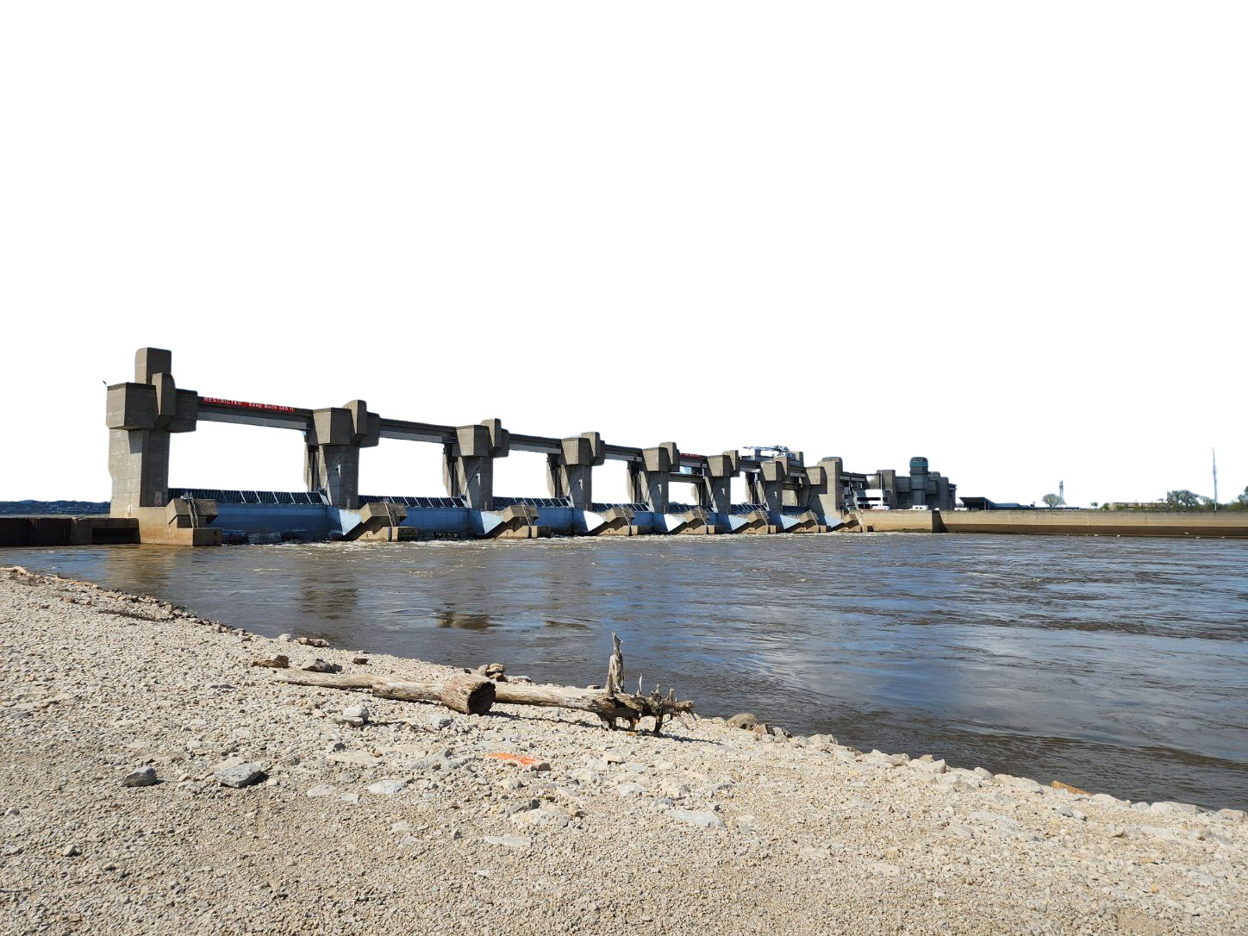

River navigation
&
Engineering
ELISE RATCLIFF, NATURAL RESOURCE SPECIALIST

Slide 2
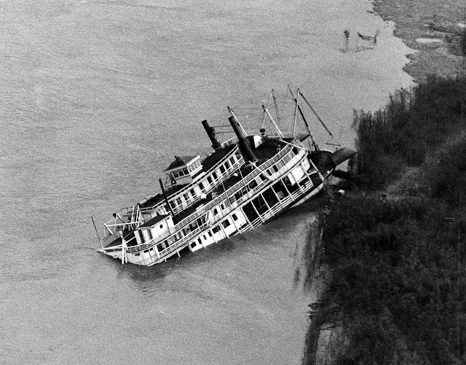
Historical problems, Modern solutions
In the 1800’s, the Mississippi River was only about 3 feet deep on average
Boats frequently got stuck or damaged on snags and sandbars
Average lifespan of a steamboat = only 18 months!
In the 1930’s, Congress tasked the USACE with dredging and maintaining a 9-foot navigation channel
A system of locks and dams was put into place to help maintain ideal river depth
Principle 1: Protect People from Water
Principle 3: Make Water Useful!

Slide 3
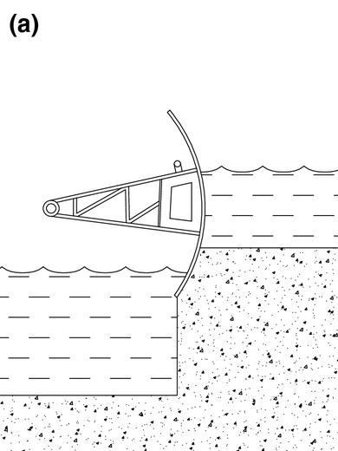
How dams work
Water is held back by tainter gates
Curved gates that swivel on a pivot
Can be raised to let more water through, or lowered to hold more back
Dams on the Mississippi typically consist of multiple tainter gates in a row
The area behind a dam is called its pool
We are Locks and Dam 26; the water immediately upstream of us is Pool 26
Each dam controls the level of the water upstream of it

Slide 4
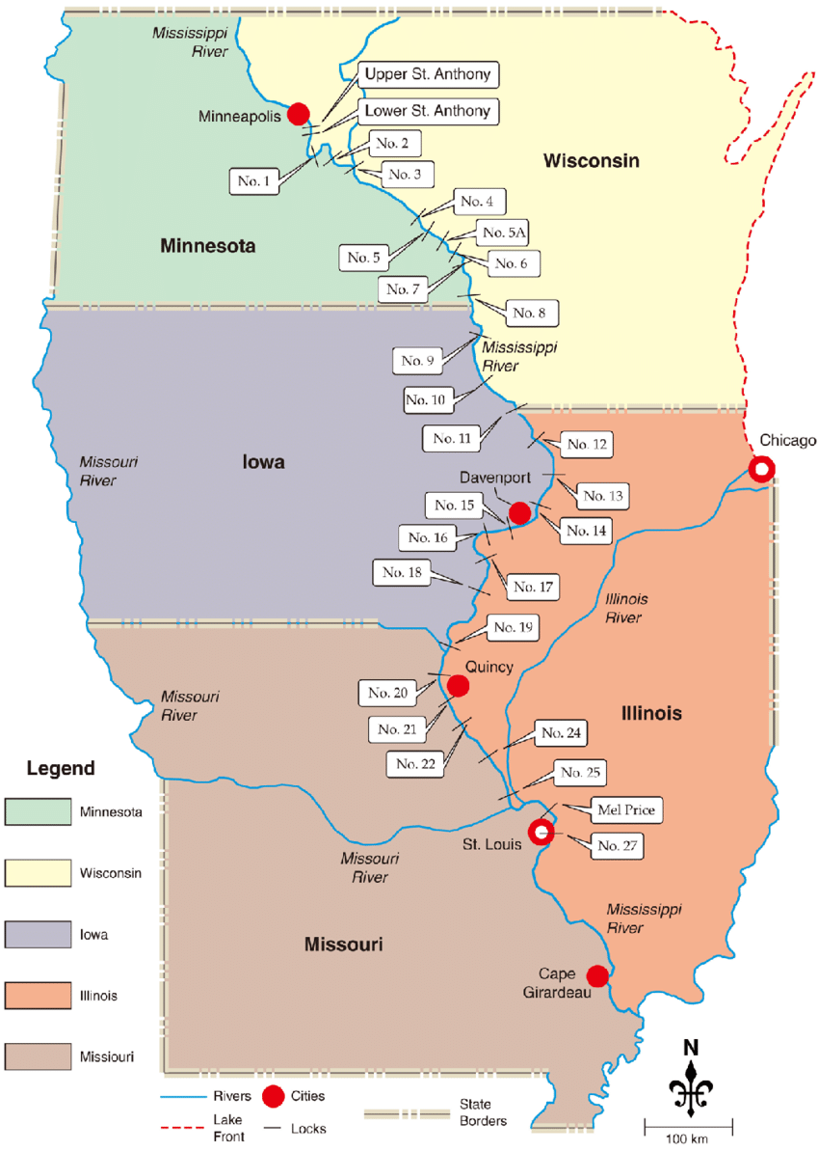
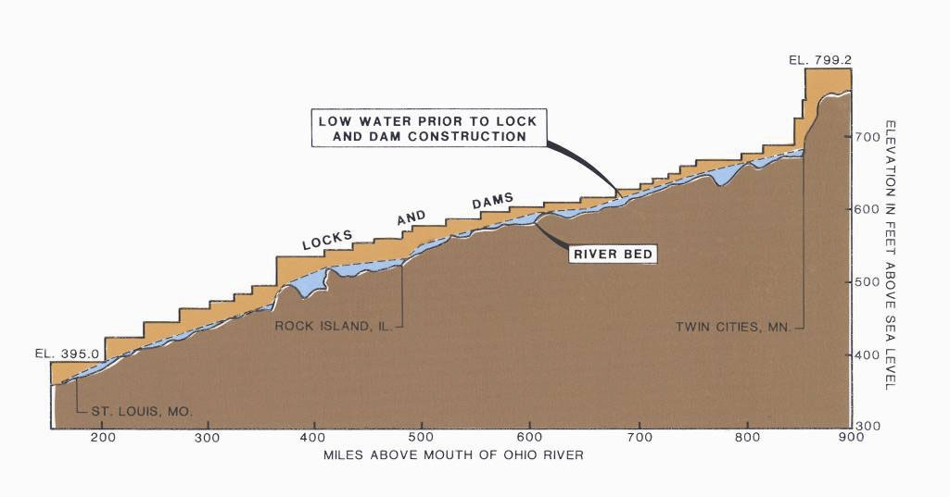
How dams work
29 lock and dams were constructed on the upper Mississippi River from Minneapolis to Granite City, IL
South of Lock 27 is open river
Confluence of Missouri with the Mississippi brings enough water to maintain depth without dams
Because there is significant elevation change from the mouth of the Mississippi to the Missouri Confluence, multiple dams are needed to account for the gradual change in depth
This creates a stair-step effect
Locks become necessary to move boats through the dam
- “Elevator” for boats to get from one water level to the next

Slide 5

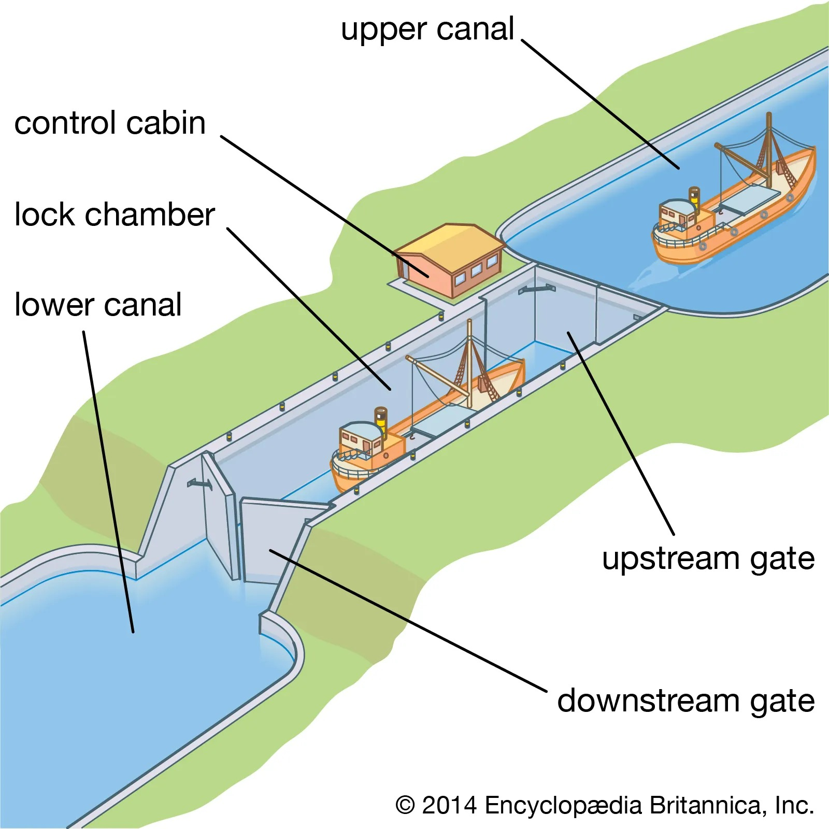
How Locks work
Miter gates (or lift gate) open
Boat moves into the chamber and ties up on the side
Lock chamber is filled or drained through pipes in the lock walls
If going upstream, water level is raised. If downstream, water level is lowered
Water movement is passive via gravity rather than pumped
Gates open, boat unties and continues on its way
This design is more typical of older locks – Melvin Price has multiple lock chambers and a control tower up above

Slide 6
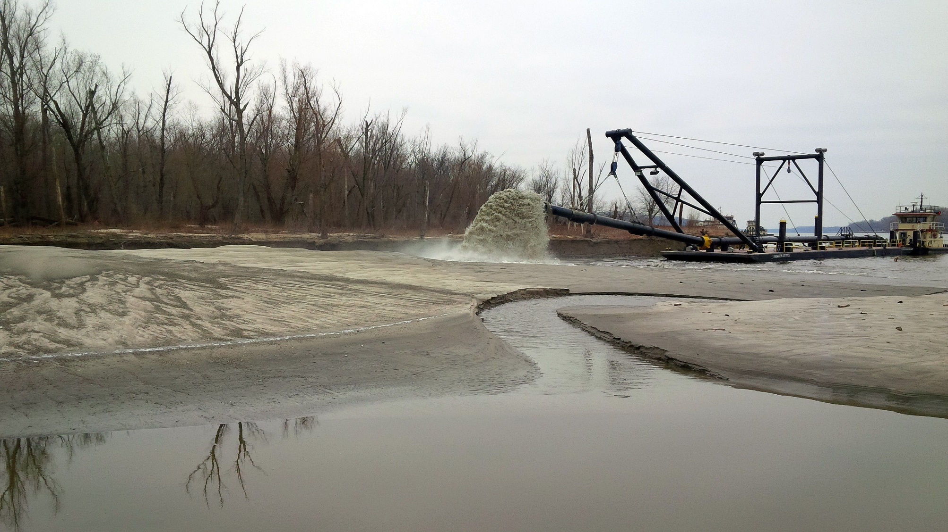
Rivers Project
The Rivers Project Office operates and maintains the last stretch of navigation channel
4 Dams and 5 Locks
3 Motor Vessels
Dredges help maintain the depth of the riverbed

Slide 7
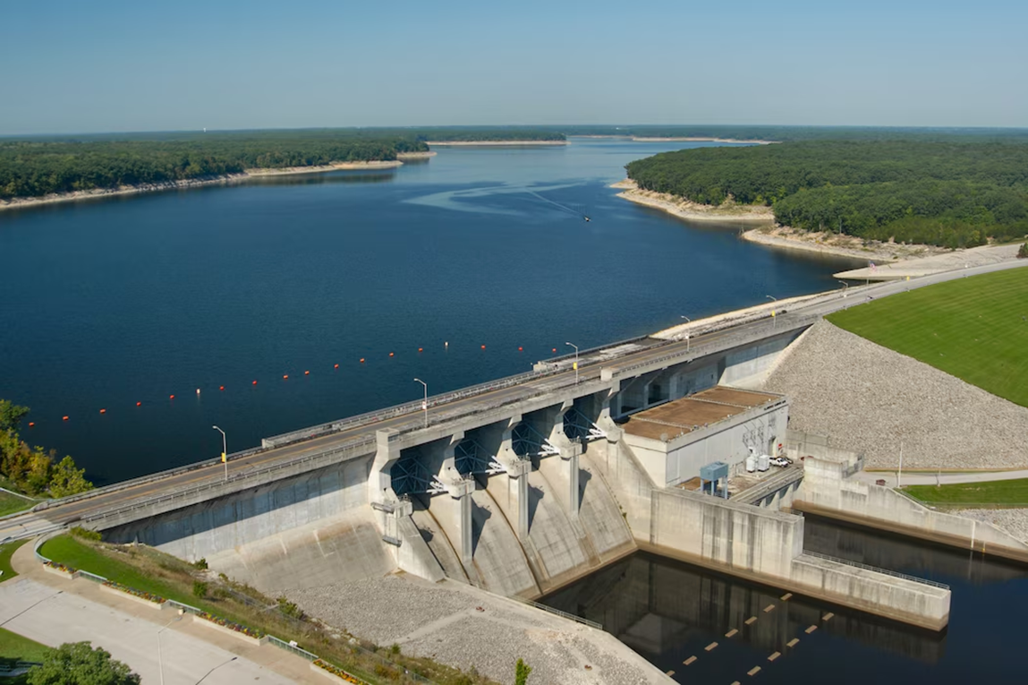
hydropower
USACE is the largest generator of hydropower in the US
75 power-producing dams housing 356 individual generating units
25% of the nation’s hydroelectric power
More than 70 billion kilowatt hours per year
Enough to power 10 cities the size of Seattle!

Slide 8
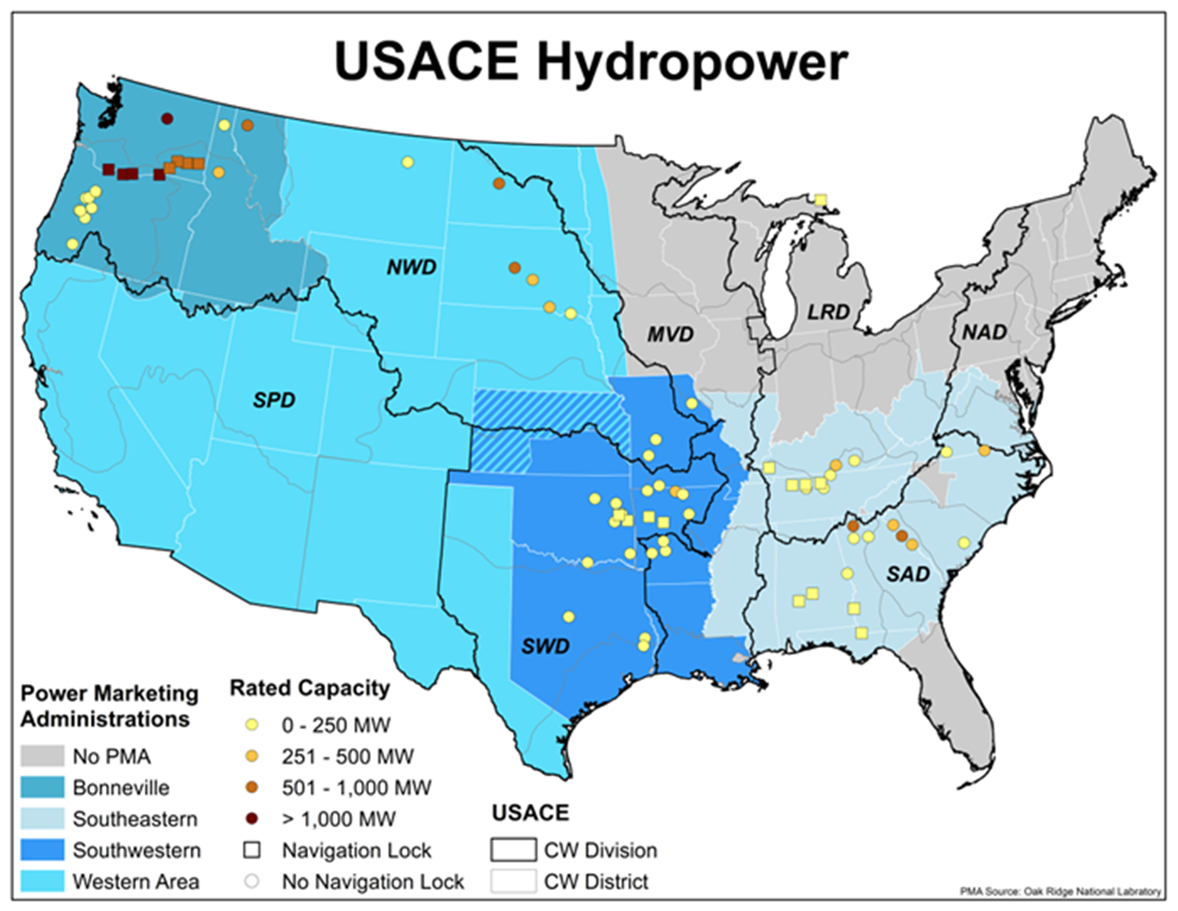
hydropower
Melvin Price is not a hydropower dam (not enough elevation change)
8 non-federal plants (private or municipal) on the Mississippi River use USACE dams to generate power
4 USACE-owned plants at reservoirs within the Mississippi Valley Division
Clarence Cannon, MO
Narrows, AR
Blakely Mountain, AR
DeGray, AR

Slide 9
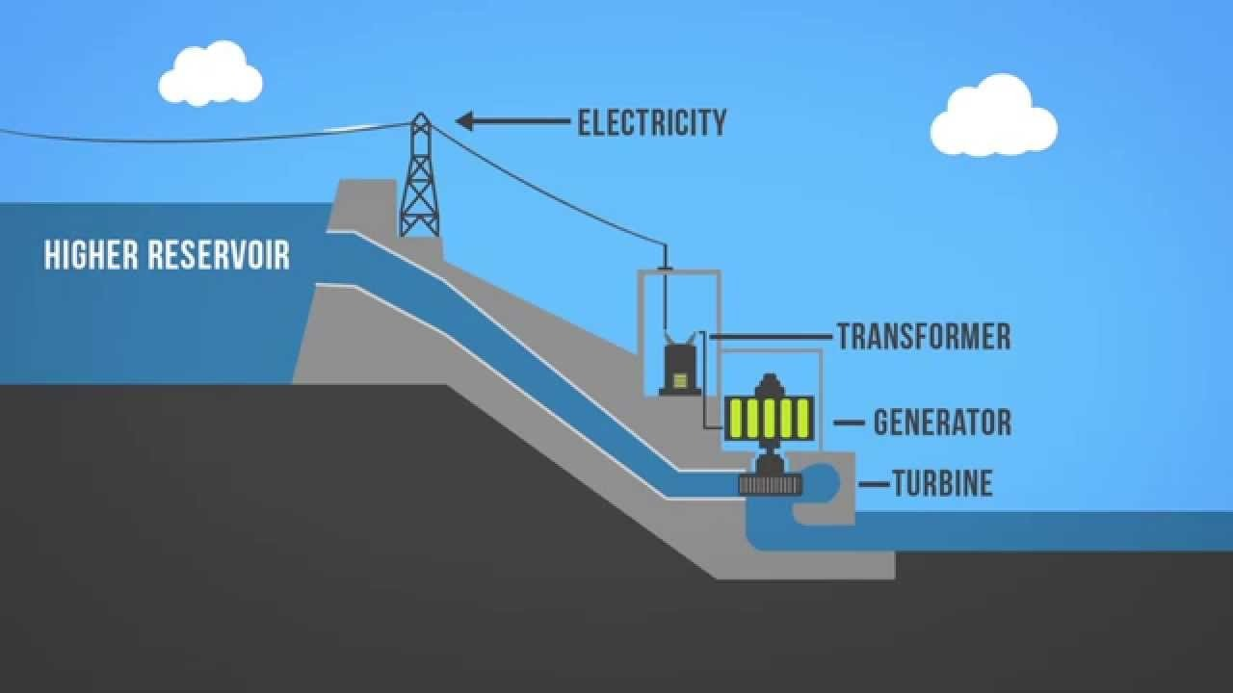






How hydropower
works
Electricity
Potential Energy
Kinetic Energy

Slide 10
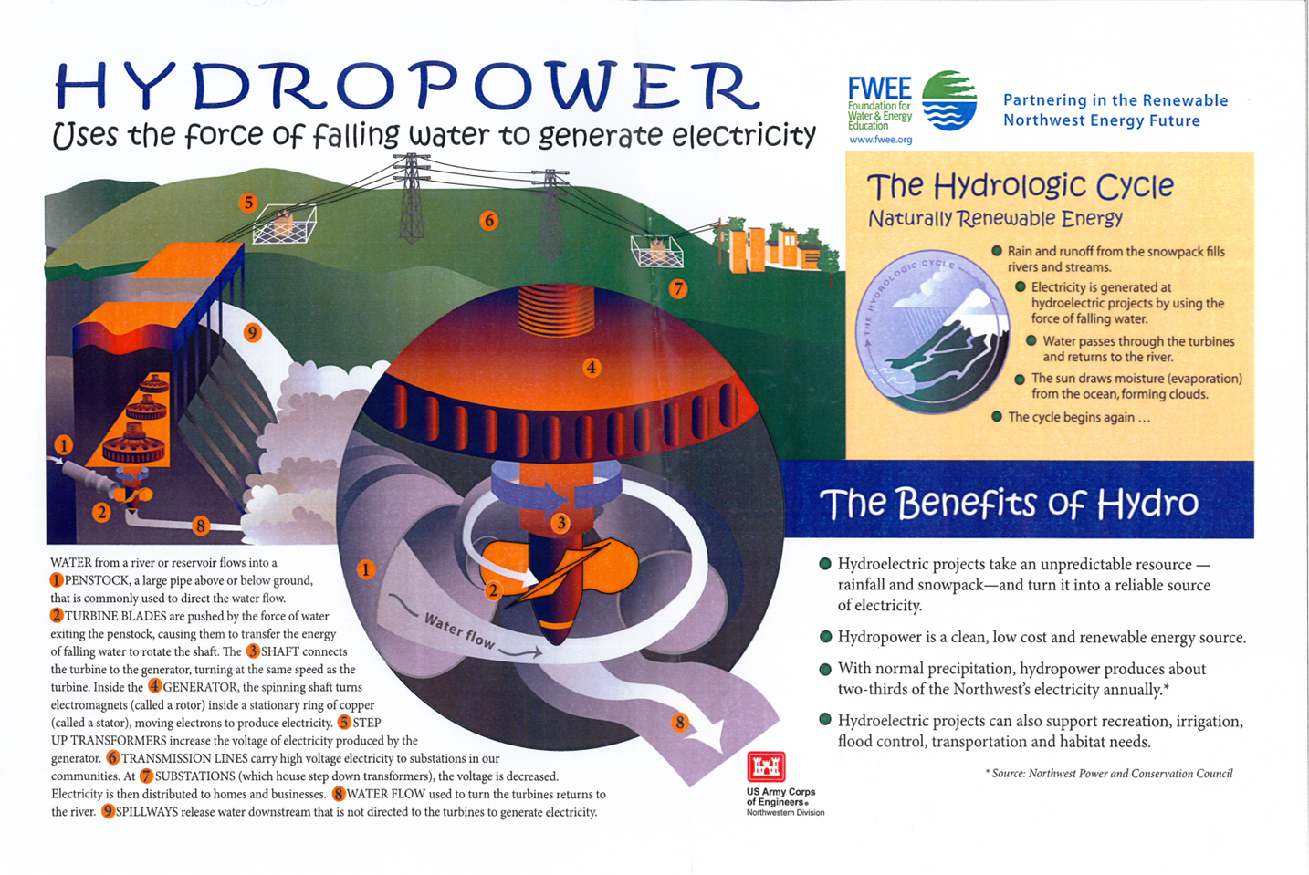
Parts of a turbine
Penstock
Big pipe that directs the water flow
Turbine blades
Water moves the blades, which turn the shaft
Shaft
Connects the turbine to a generator
Generator
The spinning shaft turns a rotor, producing electricity
Water flow
Water that returns to the river

Slide 11
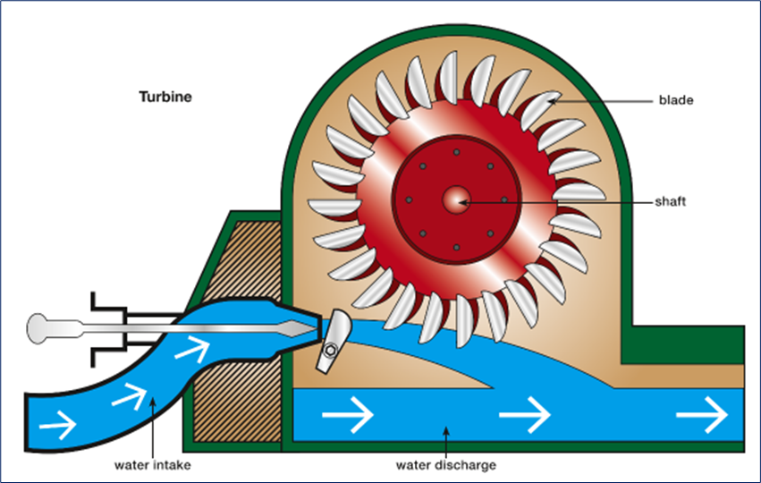
Let’s make a turbine!

Slide 12
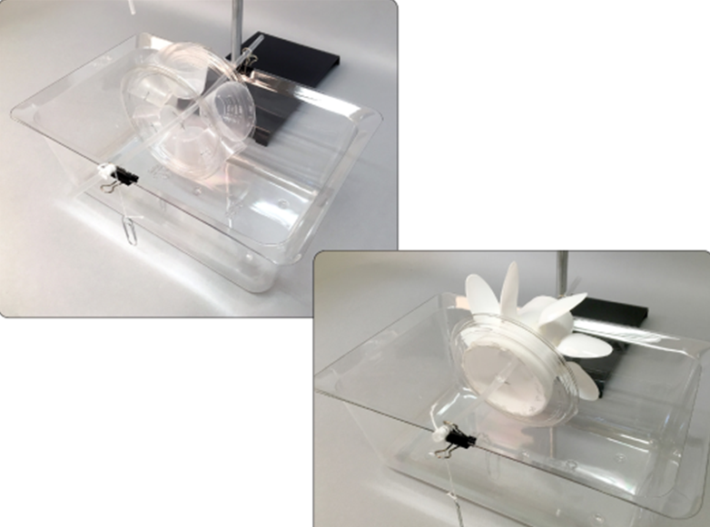
Let’s make a turbine!
Objective:
Build a water wheel that can lift a paperclip from the bottom of the container to the water wheel shaft
Supplies:
Foam cup
Small medicine cups
Big spoons
Little spoons
Straw
Tape
Lid

Slide 13
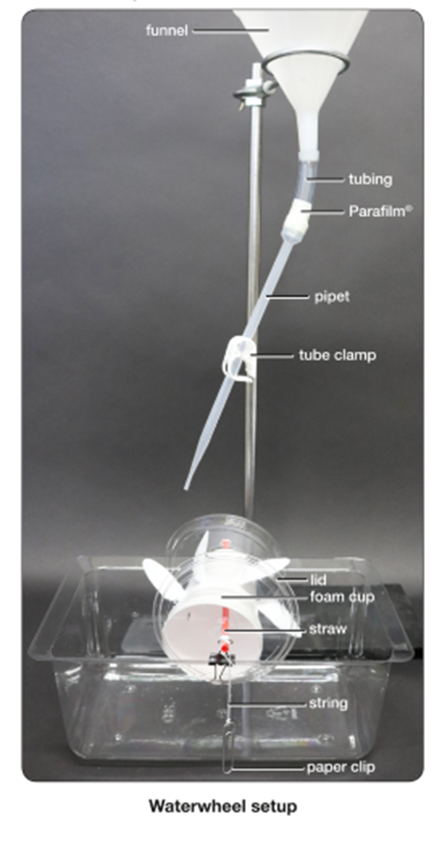
Let’s make a turbine!
Steps:
Take 2 minutes to discuss your design as a team
Send 1 teammate to gather all supplies from front table
Plastic Tub
Straw
String
Paper Clip
Binder Clip
Construct your design ~20 minutes
Once you have completed your design, come to the front testing area to test your device!
Redesign as needed

Slide 14
In the classroom
This is a versatile activity that can be tailored to a variety of age ranges
Additional challenges for older students can include adding or removing materials, changing the flow rate of the water, and asking them to hypothesize what might happen when variables are changed
Potential questions:
What about your hydroelectric power generator design worked successfully?
What about your hydroelectric power generator design did not work?
If you were to return to the design process, how would you change your design to make your water wheel more effective?
How does your model compare with what you know of large-scale hydroelectric generators?
What are the advantages and disadvantages of using hydroelectric power?

