Slide 1



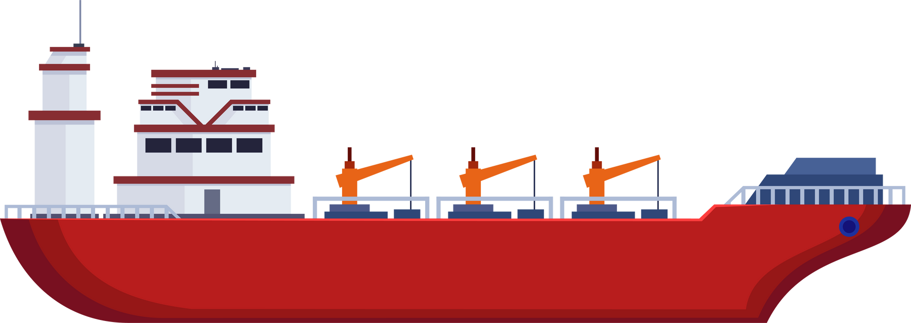



RIVER
ECONOMICS
Elise Ratcliff
Natural Resource Specialist

Slide 2
FAST
FACTS
The USACE Navigation system moves over 500 million tons of commodities annually
Over 2.5 million are transported on the Mississippi River alone
Water transportation primarily moves bulk products, vs. trucks and air transport which carry more high-value and mixed freight

Slide 3
FAST
FACTS
River transportation is incredibly efficient!
The inland navigation system saves between 7 and 9 billion dollars annually over other transportation methods.
On one gallon of fuel, a towboat can move one ton of cargo 647 miles - a truck can only do 145!
That towboat also emits fewer carbon dioxide emissions - 15.2 grams/ton mile vs. 154.08 for a truck.
This is largely due to differences in cargo capacity.

Slide 4


FAST
1
FACTS
15-barge tow
=

Slide 5

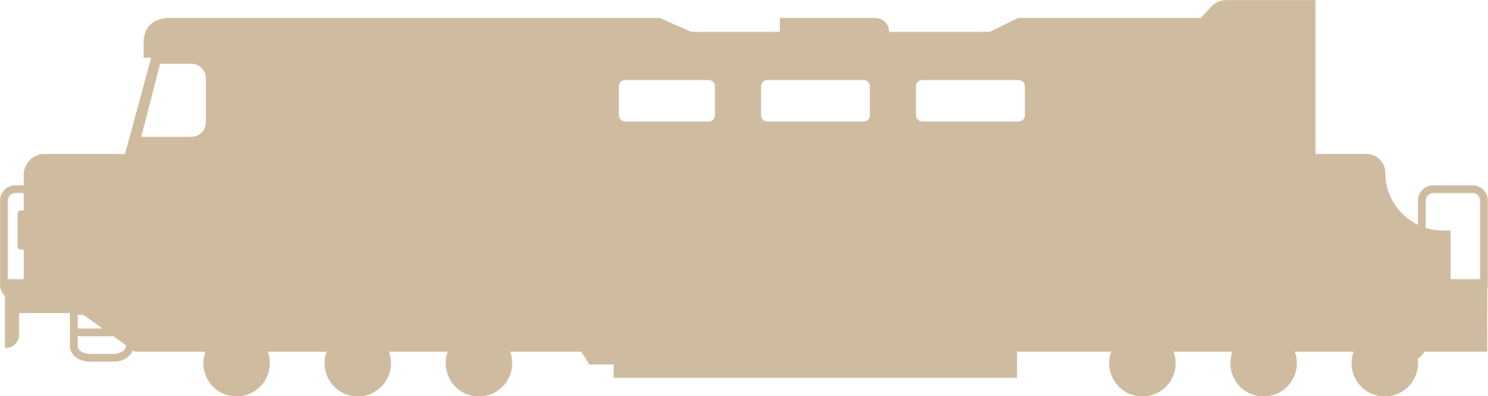
FAST
6
216
Rail Cars +
Locomotives
FACTS
=

Slide 6
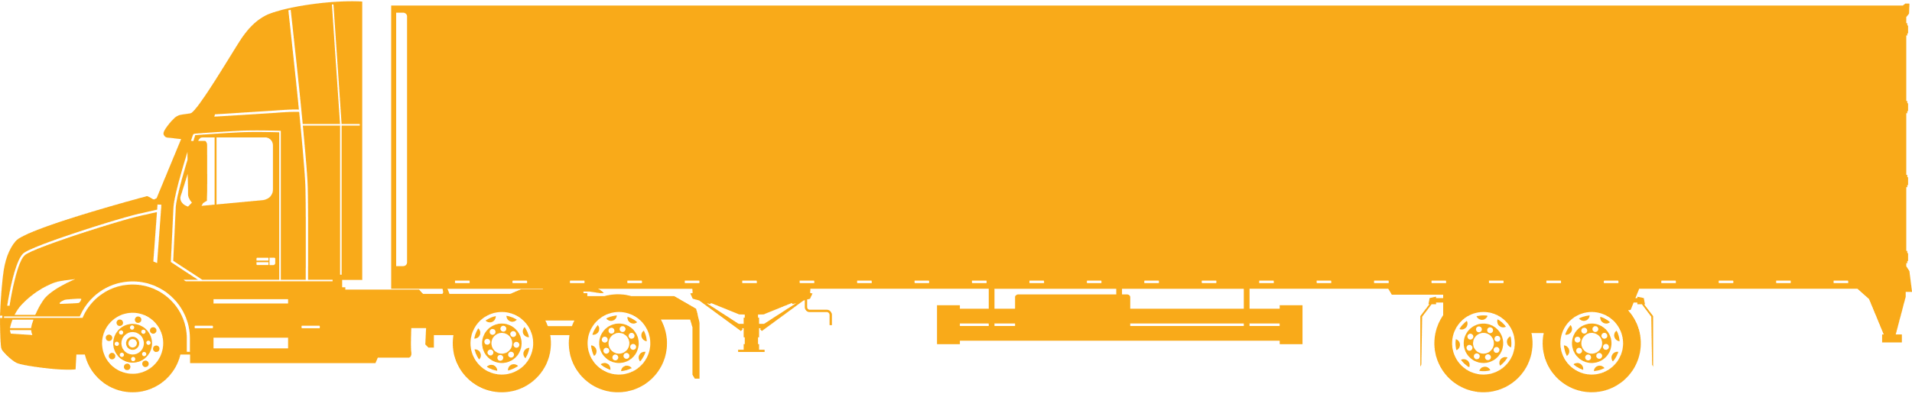
FAST
1,050
Semi Trucks
FACTS

Slide 7
LET’S TRY A
WORD PROBLEM:
One barge container can hold up to 50,000 bushels of wheat.
If one bushel of wheat produces 42 commercial loaves of bread, how many loaves of bread can be produced from a single barge container full of wheat?
How about from one standard barge tow? (Think back - do you remember how many containers is standard?

Slide 8
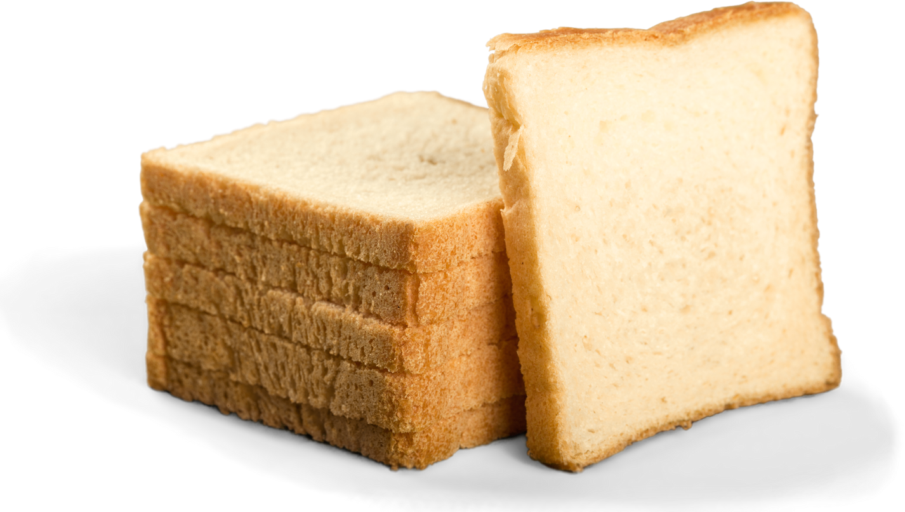
HERE’S THE
ANSWER:
One barge container full of wheat can produce
2.1 MILLION
loaves of bread!

Slide 9
HERE’S THE
ANSWER:
One standard barge tow (15 barges) can produce
31.5 MILLION
loaves of bread!

Slide 10
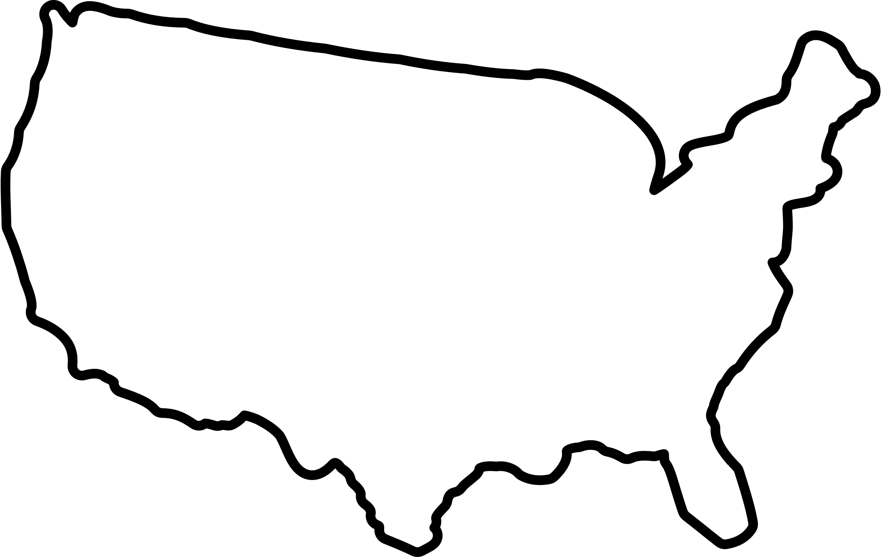
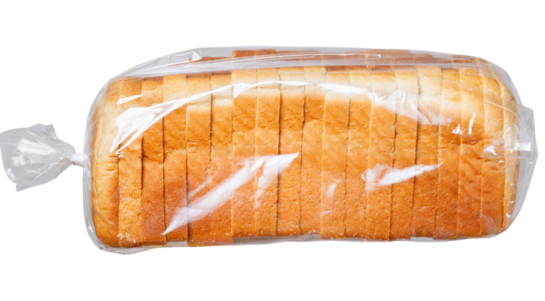
HERE’S THE
ANSWER:
OR....
Enough bread to stretch from one end of the United States to the other - TWICE!

Slide 11

SHOW YOUR
WORK:
31.5 million loaves of bread, each a foot long, stretched end-to-end: 31.5 million ft
31.5 million ft / 5,280 ft in a mile = 5,965.9 miles
The length of the continental United States is roughly 2,800 miles.
5,965 miles / 2,800 miles = 2.13
(how many laps our bread train could do)

Slide 12
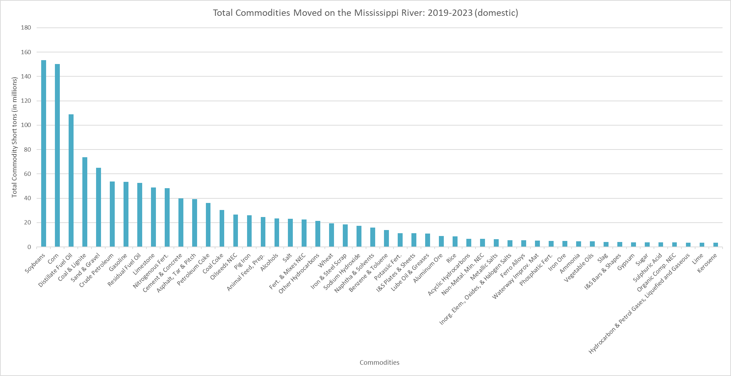
WHICH GOODS TRAVEL
THE MISSISSIPPI RIVER?
This is just the top 50 goods!

Slide 13
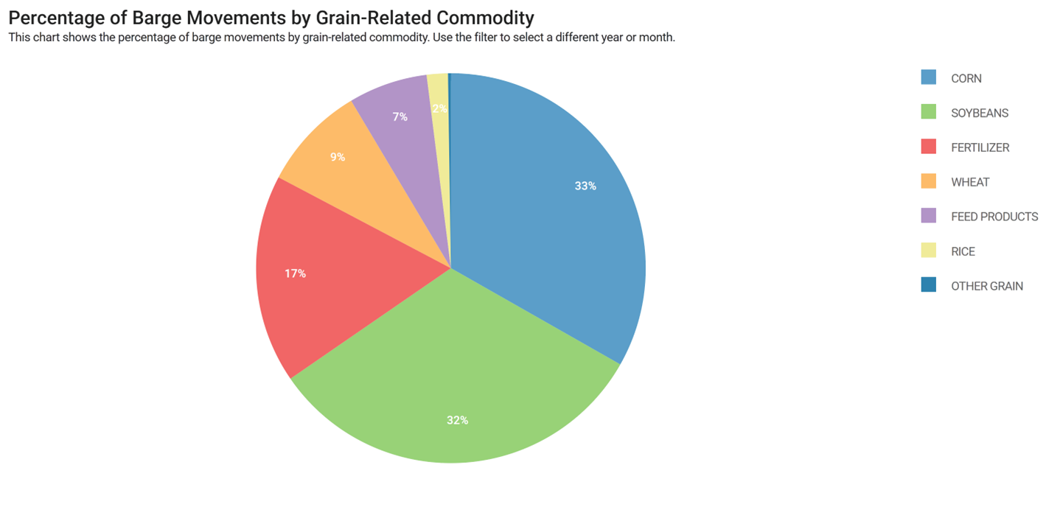
WHICH GOODS TRAVEL
THE MISSISSIPPI RIVER?

Slide 14
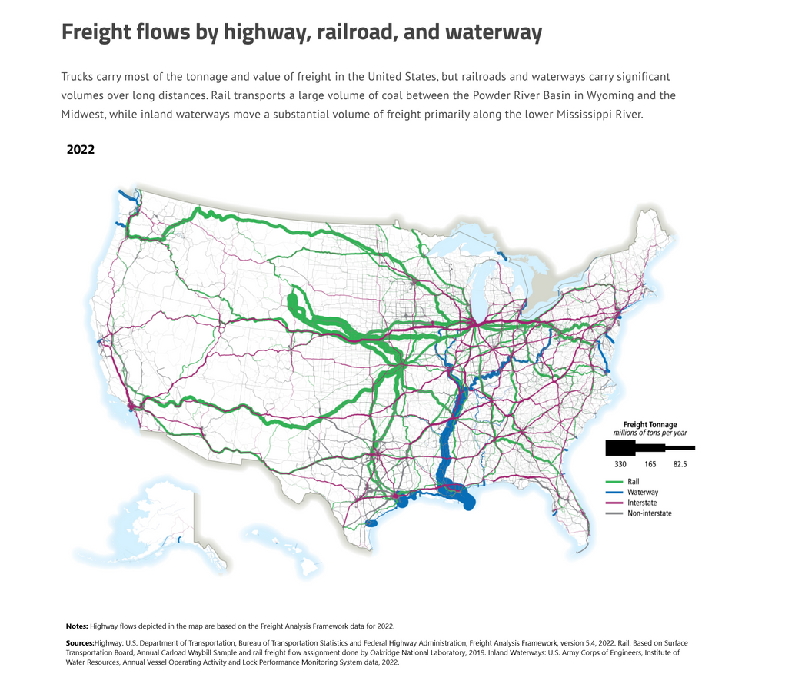
WHICH GOODS TRAVEL
THE MISSISSIPPI RIVER?

Slide 15
GOOD PLACES TO
FIND STATS
USACE Waterborne Commerce Statistics Center (WCSC)
Commerce data, vessel data, navigation infrastructure and GIS
https://www.iwr.usace.army.mil/About/Technical-Centers/WCSC-Waterborne-Commerce-Statistics-Center/
US Department of Transportation Bureau of Transportation Statistics: Freight Facts and Figures
https://data.bts.gov/stories/s/Moving-Goods-in-the-United-States/bcyt-rqmu/
https://data.bts.gov/stories/s/Freight-Transportation-System-Extent-Use/r3vy-npqd
USDA
Ag-related barg
https://agtransport.usda.gov/stories/s/Barge-Dashboard/965a-yzgy/

Slide 16
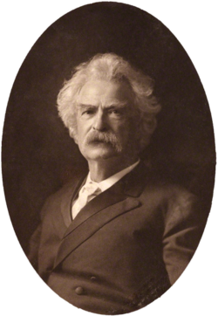
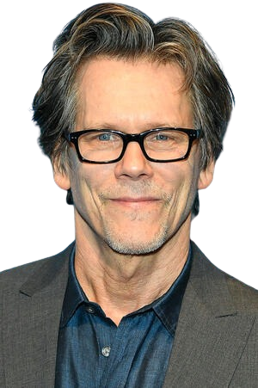

LET’S PLAY.....
6 DEGREES OF KEVIN BACON!
Mississippi River

Slide 17



HOW IT WORKS

Slide 18
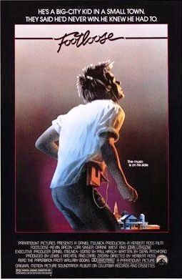






HOW IT WORKS

Slide 19
HOW IT WORKS
2
o

Slide 20
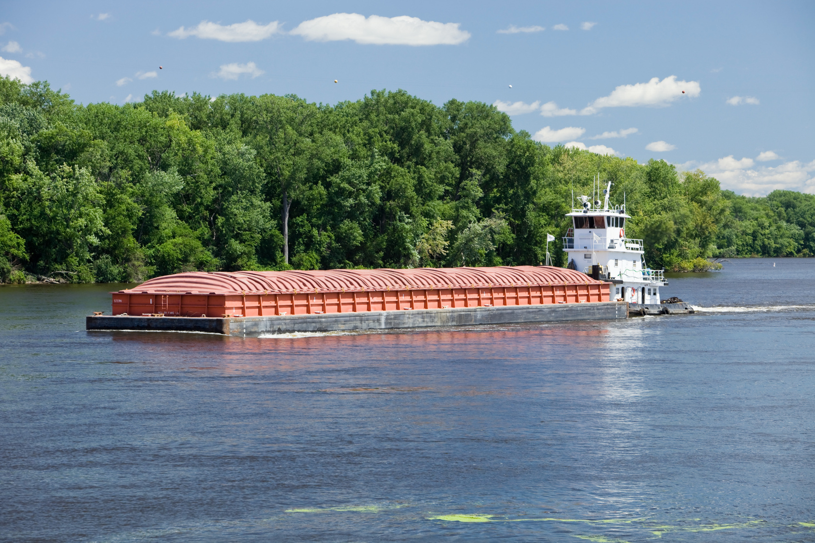
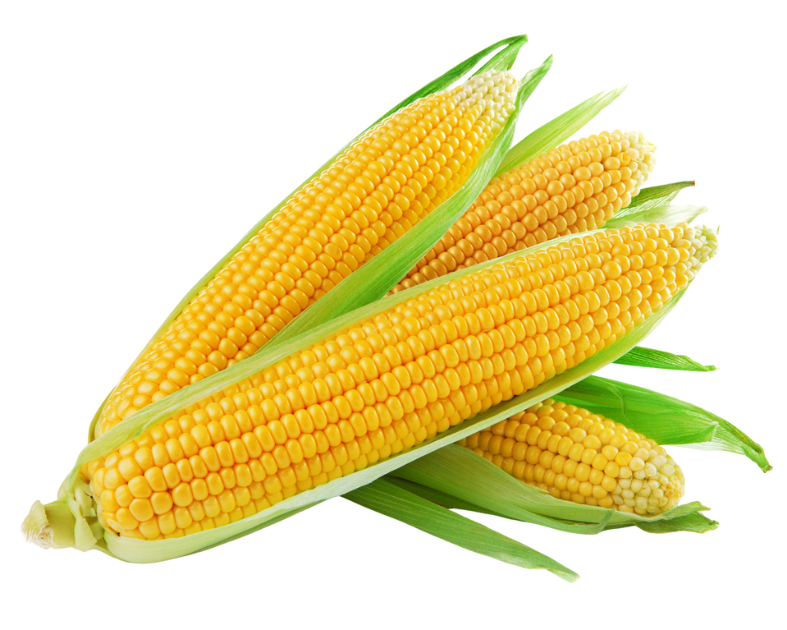
HOW IT WORKS

Slide 21

HOW IT WORKS

Slide 22
HOW IT WORKS
1
o

Slide 23

HOW IT WORKS

Slide 24


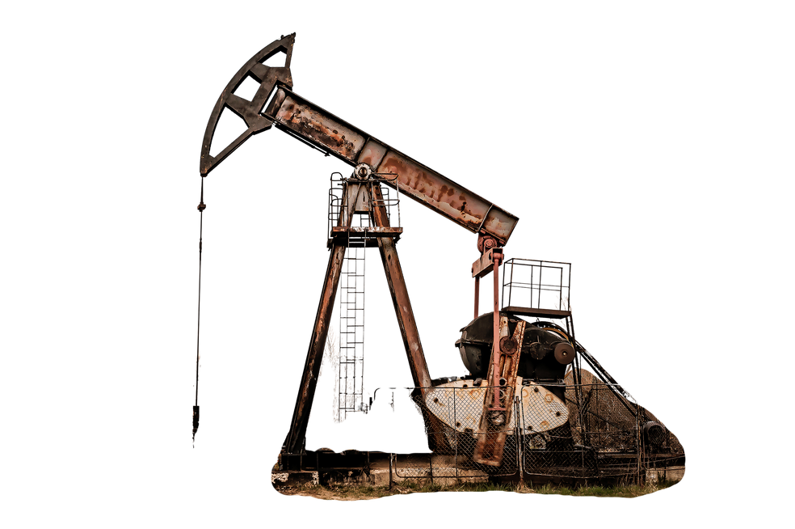
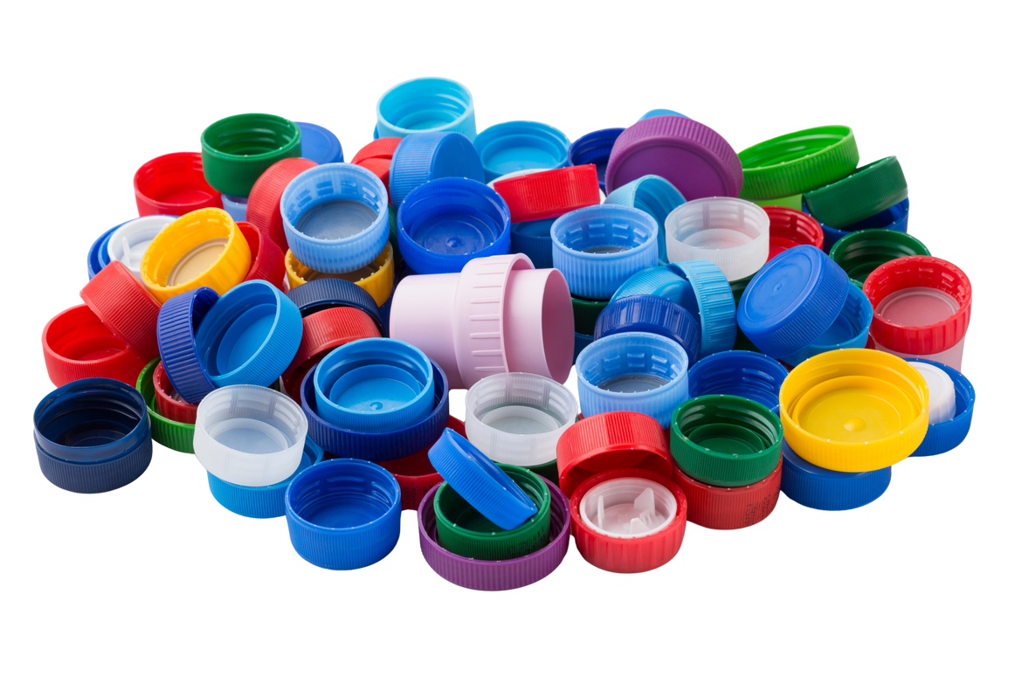
HOW IT WORKS

Slide 25
HOW IT WORKS
3
o

Slide 26
GAME RULES
1. You have 30 seconds to tie the image on the screen back to the river using the sheet in front of you. For the purpose of this game, we are only using the top 50 goods.
2. When your team has successfully found your connection, grab the ___
3. The team that grabbed it first gets to give their connection. If the other team also has a connection, they may give it after that team finishes. The first team wins a point UNLESS the second team has successfully tied it back using fewer degrees.
4. When giving your connection, first state the number of degrees and then explain your steps. If you are correct but misstate the number of degrees, the other team gets the point.
5. Anything in the image is fair game.
6. No using phones/google
7. In the event of a tie, the breaker will be determined by how high on the list the good you tied back to is.
8. Ranger gets final say!

Slide 27
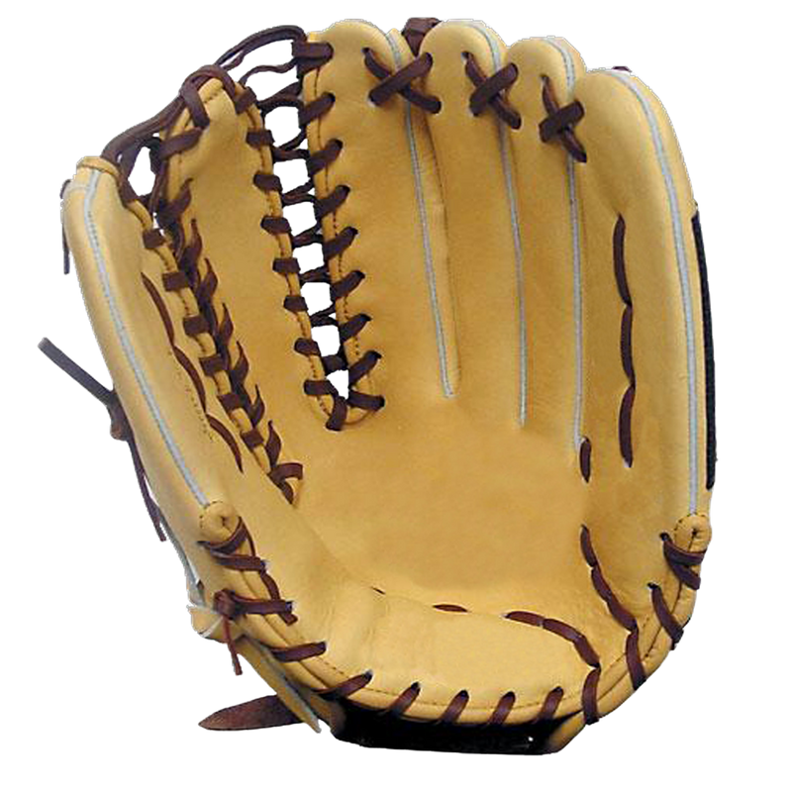
HOW MANY DEGREES?

Slide 28
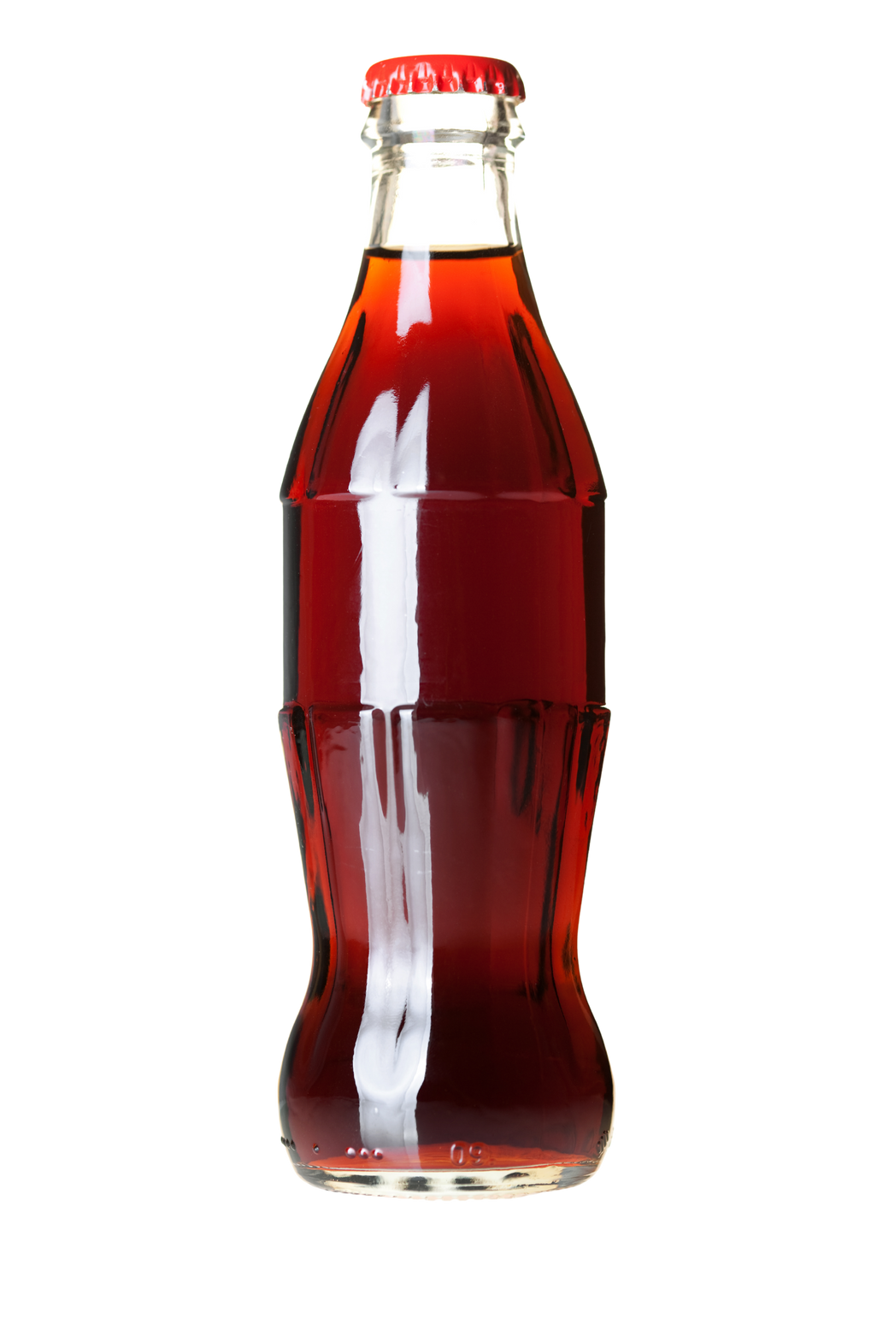
HOW MANY DEGREES?

Slide 29

HOW MANY DEGREES?

Slide 30
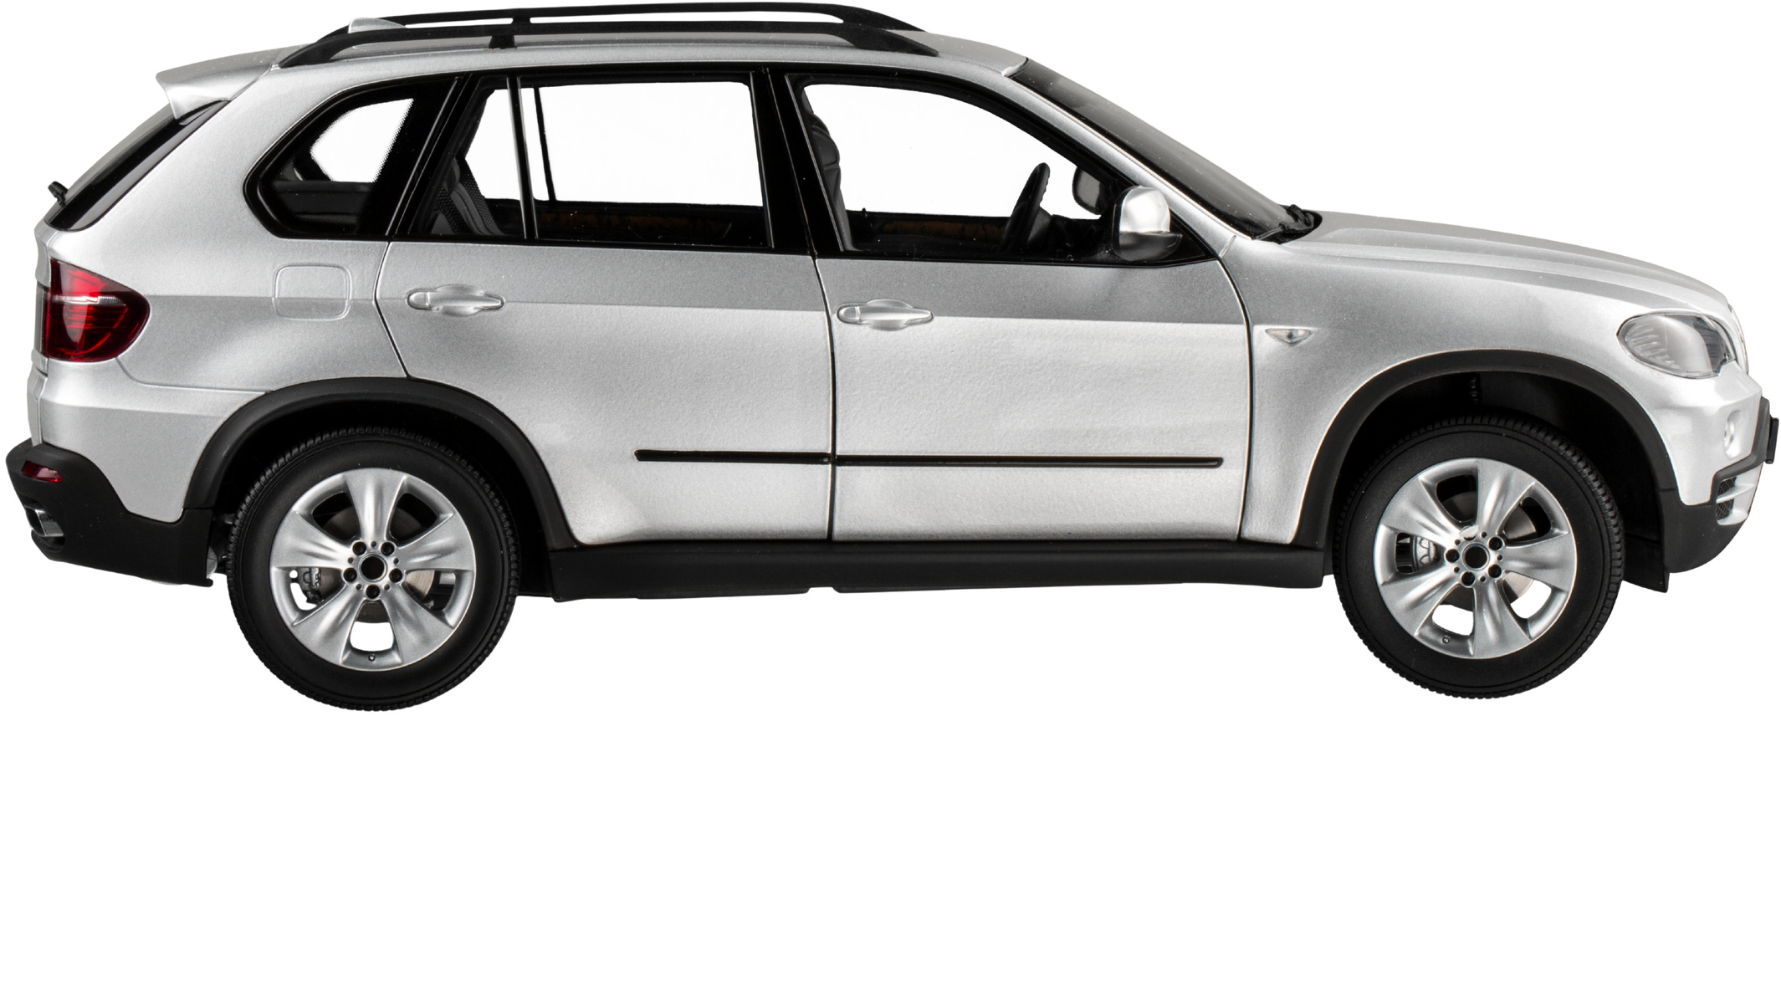
HOW MANY DEGREES?

Slide 31
BONUS ROUND
In the true spirit of Kevin Bacon, this round will be played using only scenes from movies.
Rather than trying to find the shortest degree of connection, you will have 60 seconds to find as many connections as you can.
Teams will write down every item in the scene that they can tie back to the river within the allotted time. When time is called, pencils must be dropped.
The team with the largest number of DEFENSABLE items wins!
Each item may only be counted once, ie. if there is a flower garden, you may only count “flower” once. Exceptions are made for items that are the same but have different connections, ie. plastic bottle vs glass bottle.
You will need to be able to justify each item you list, in detail. If you can’t sufficiently explain it, it doesn’t count.
Anything in the scene is fair game
Ranger gets final say!

Slide 32
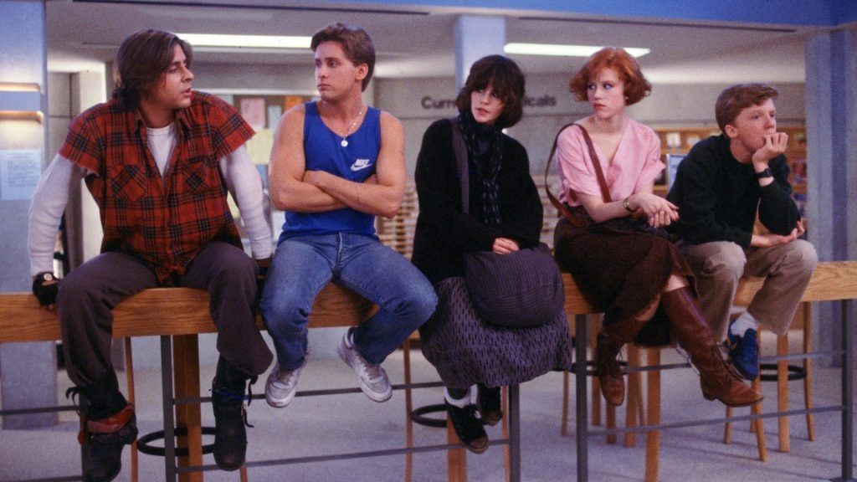
HOW MANY CONNECTIONS?

Slide 33
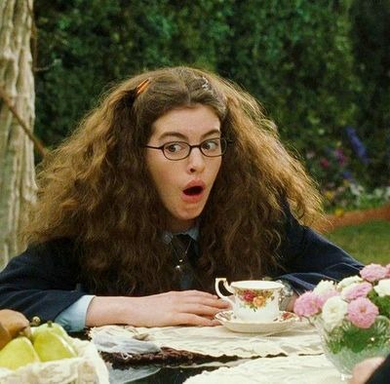
HOW MANY CONNECTIONS?

Slide 34
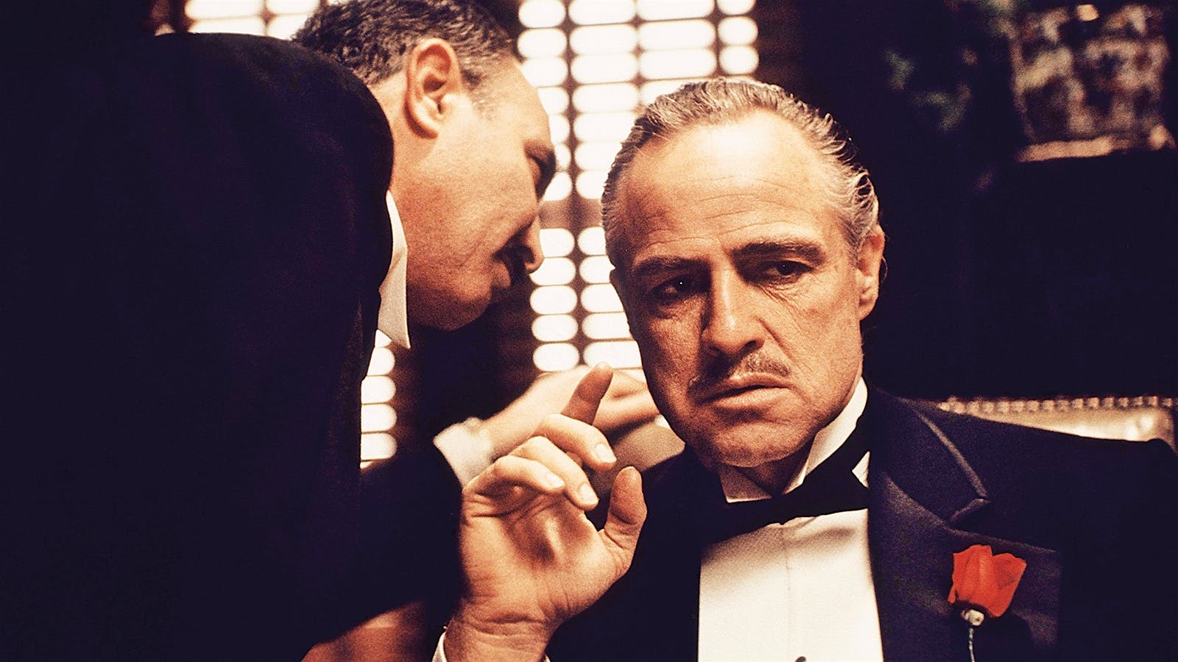
HOW MANY CONNECTIONS?

Slide 35

HOW MANY CONNECTIONS?

Slide 36
IN THE CLASSROOM
This activity can be catered to various age ranges and topics, and it provides opportunities to talk about supply chain, agriculture, industry, and trade in the U.S. as a whole.
Further questions:
How many items around you can be tied to (Agriculture, Illinois/Missouri, the Midwest, etc.)?
- This does not have to be the river! It can be tailored according to your focus area.
Was it easier or harder than you thought it would be to tie the items back to ___?
Can you think of any goods we didn’t mention?
Why do you think most of these items aren’t transported individually on barges? Is there a better way of transporting them?
River freight is very important in the Midwest, but is a less popular option out west. Why would that be?
River transportation is cheaper, better for the environment, and more efficient than every other method of freight transportation in the U.S. Could we someday move entirely to river transportation for our supply chain? Why or why not?

