Slide 1







Environmental
Stewardship
ELISE RATCLIFF
NATURAL RESOURCE SPECIALIST

Slide 2
Why
Environmental Stewardship?
Principle 2:
PROTECT WATER FROM PEOPLE!

Slide 3
Rivers Project
Environmental Stewardship
WE:
  EMPLOY FORESTERS, WILDLIFE BIOLOGISTS, AND NATURAL RESOURCE SPECIALISTS
  Manage 49,000 acres of land
  Manage invasive species, restore native habitats, and monitor wildlife populations

Slide 4
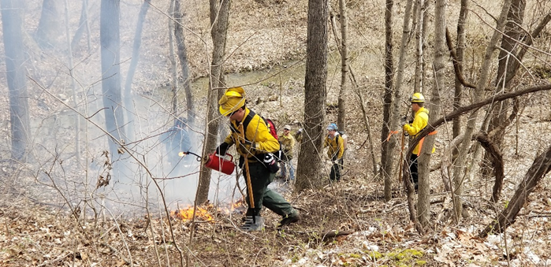
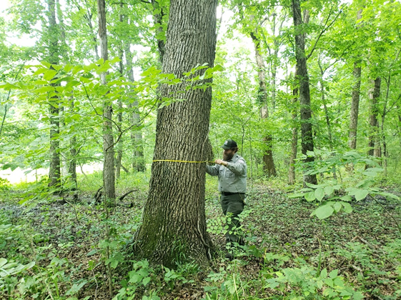
Habitat Management:
Forestry
  Timber stand improvement
  Reforestation
  Prescribed burns
  Forest monitoring
  Invasive treatments

Slide 5
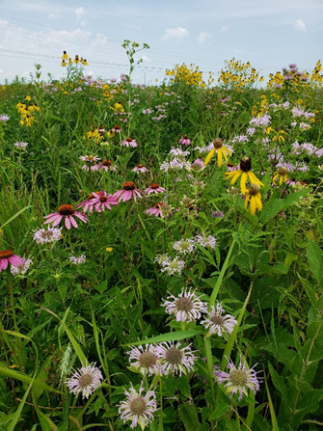
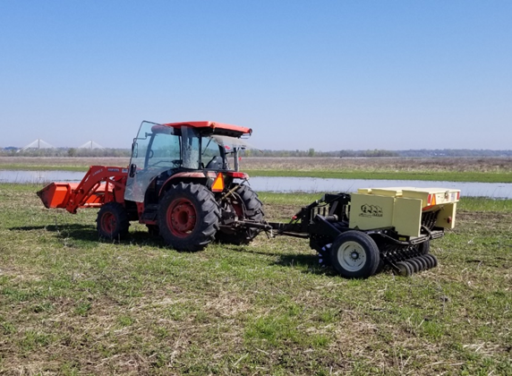
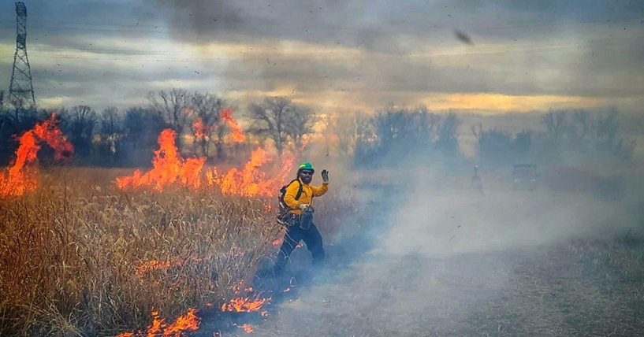
Habitat Management:
Grasslands
  Prescribed burns
  Planting
    Seeding
    Greenhouse containers
  Mowing and Disking
  Invasive species and woody encroachment treatment

Slide 6
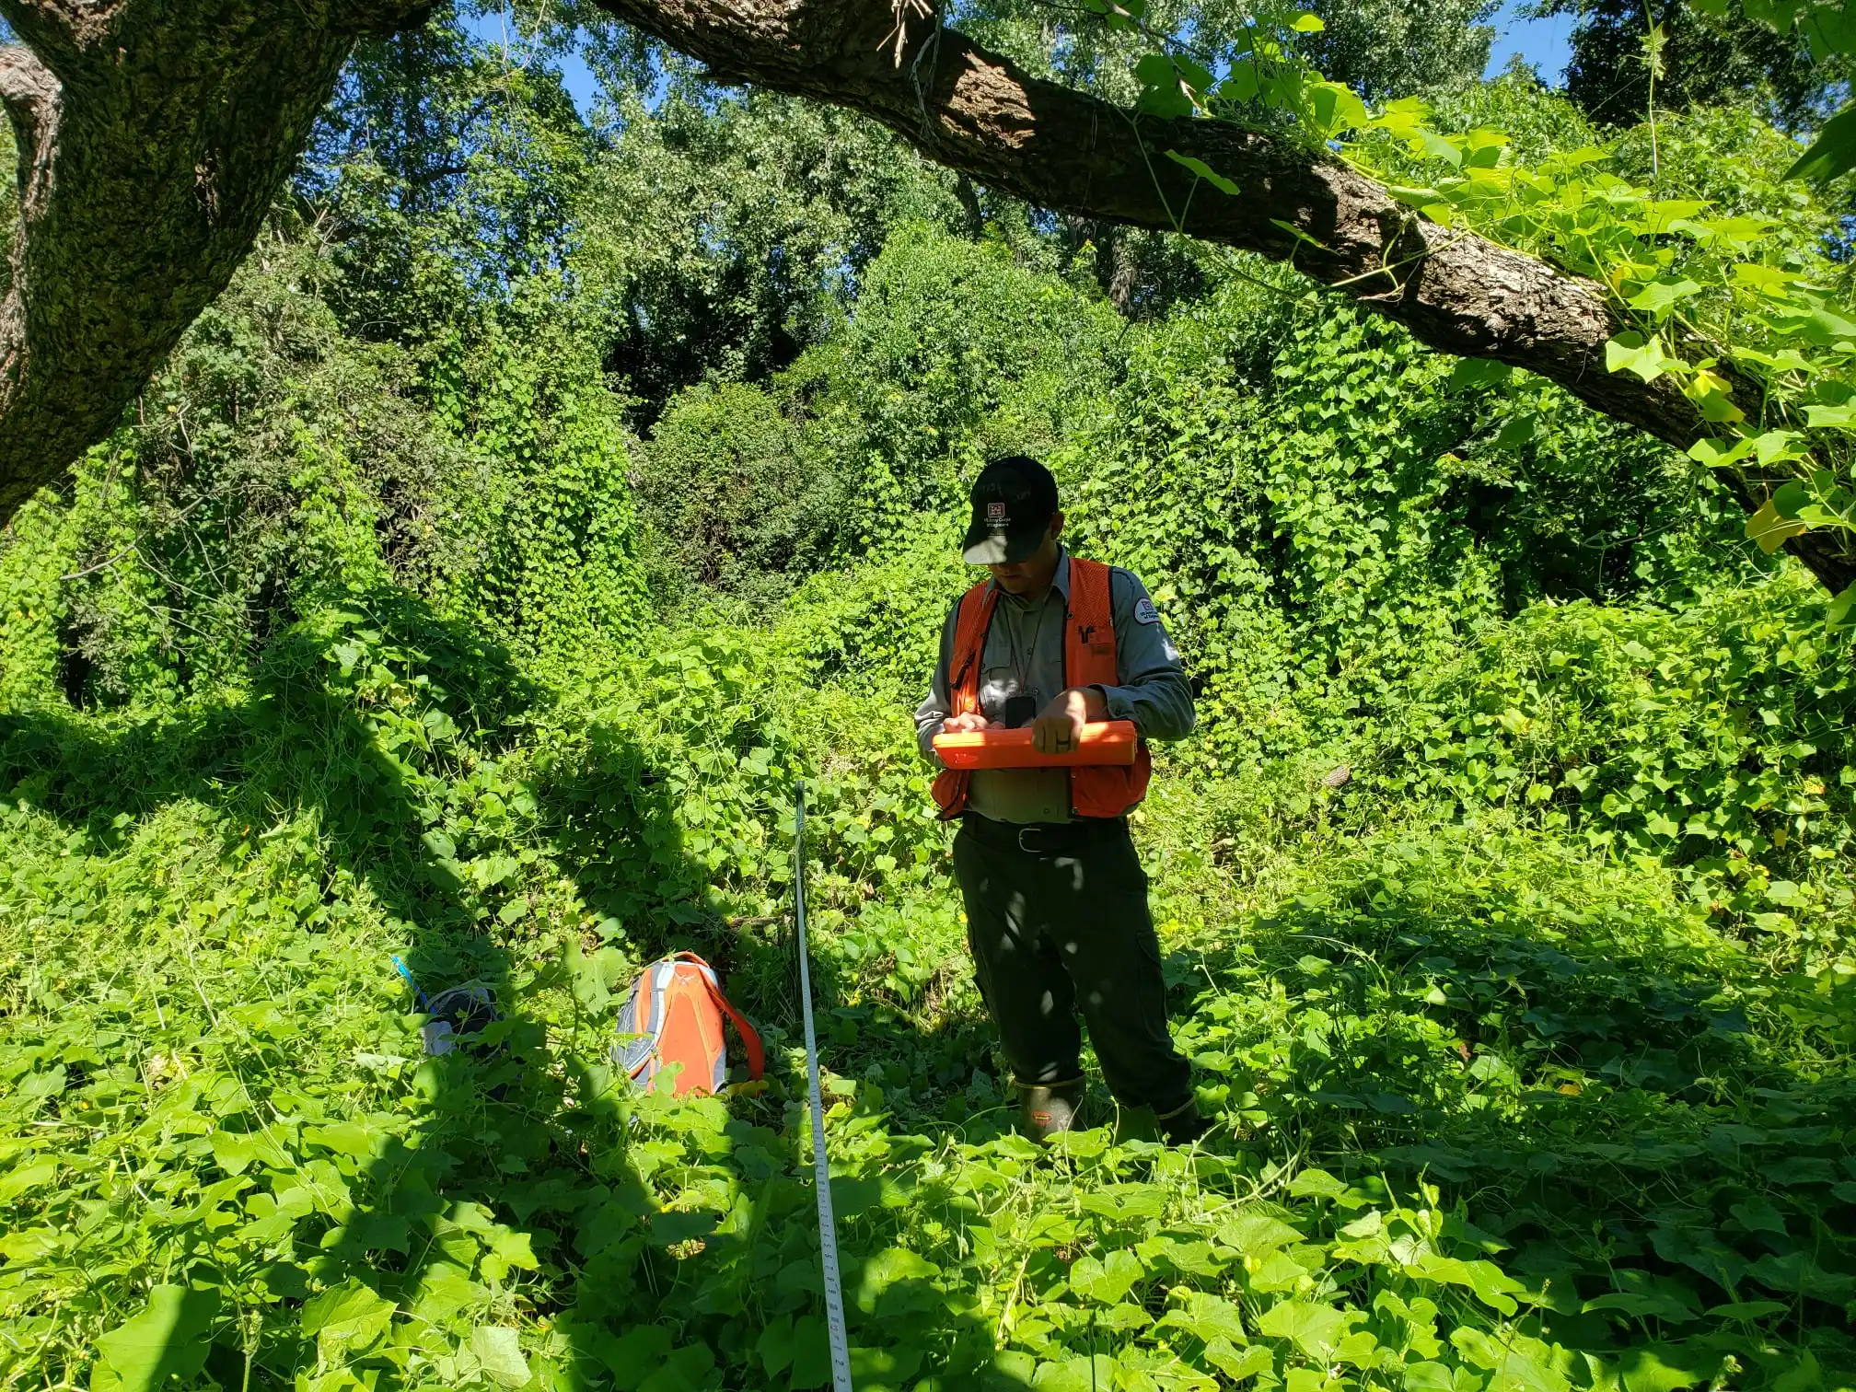
Habitat Management
Invasive Species
  Problem species on the river
    Bush Honeysuckle
    Japanese Hops
    Asian Carp
    Zebra Mussels
    Japanese Stiltgrass
  Management
    Prescribed burns
    Herbicide treatments
    Manual removal
    Planting trees to “shade out” invasives

Slide 7
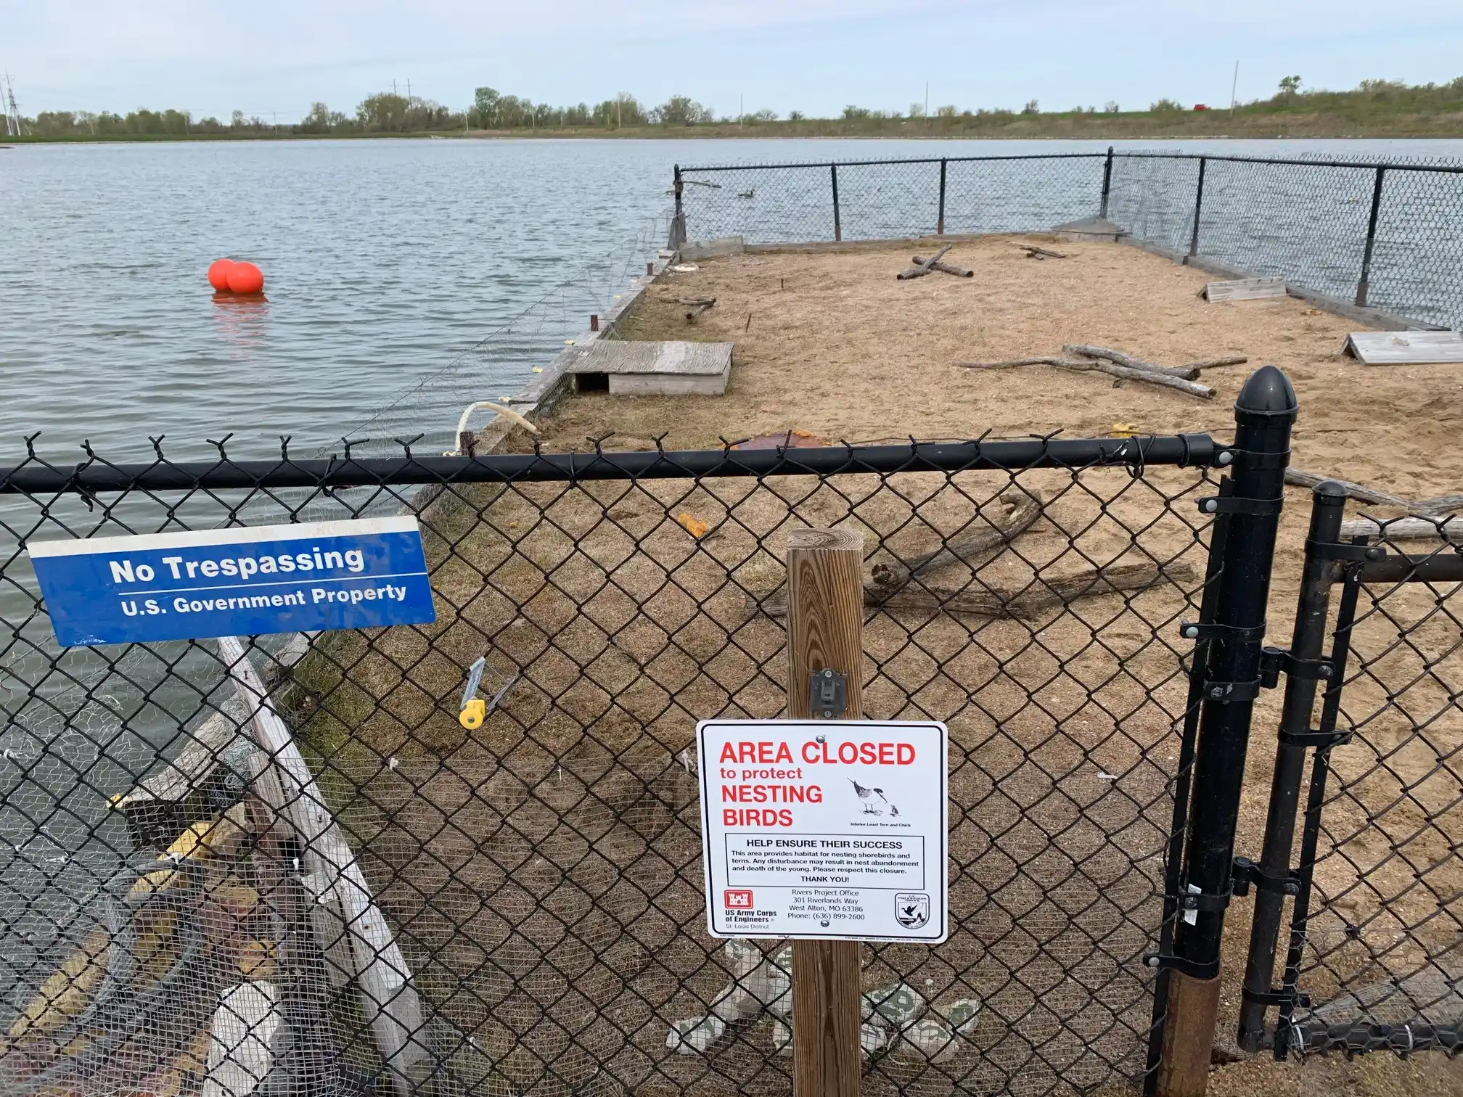
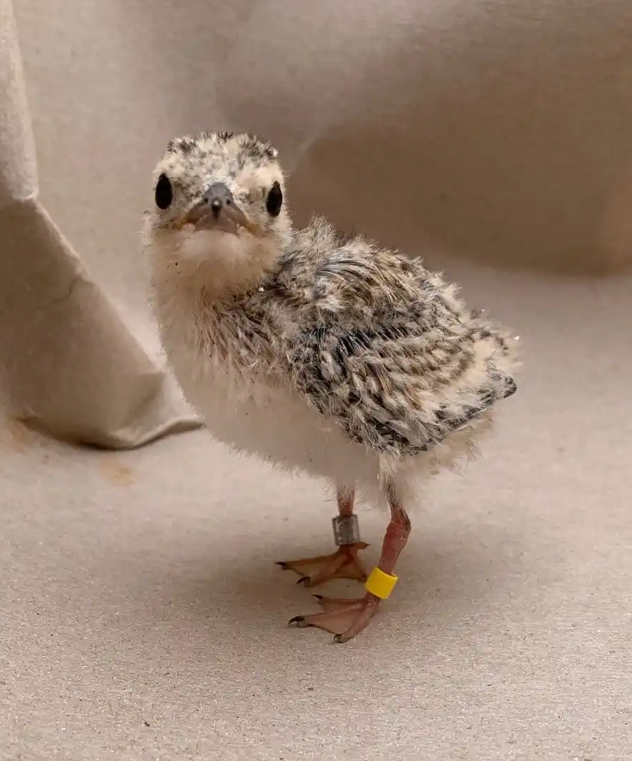
Wildlife Monitoring
Least Terns
  Previously endangered, de-listed in 2021
  Tern barge
    Experiment to see if Least Terns would nest on artificially created habitat
      Decoys and nesting habitat
      Nest monitoring
    It worked!
      250 chicks hatched from 2009-2022 with 178 chicks banded
    Barge was retired due to wear and tear and the de-listed status of the terns

Slide 8
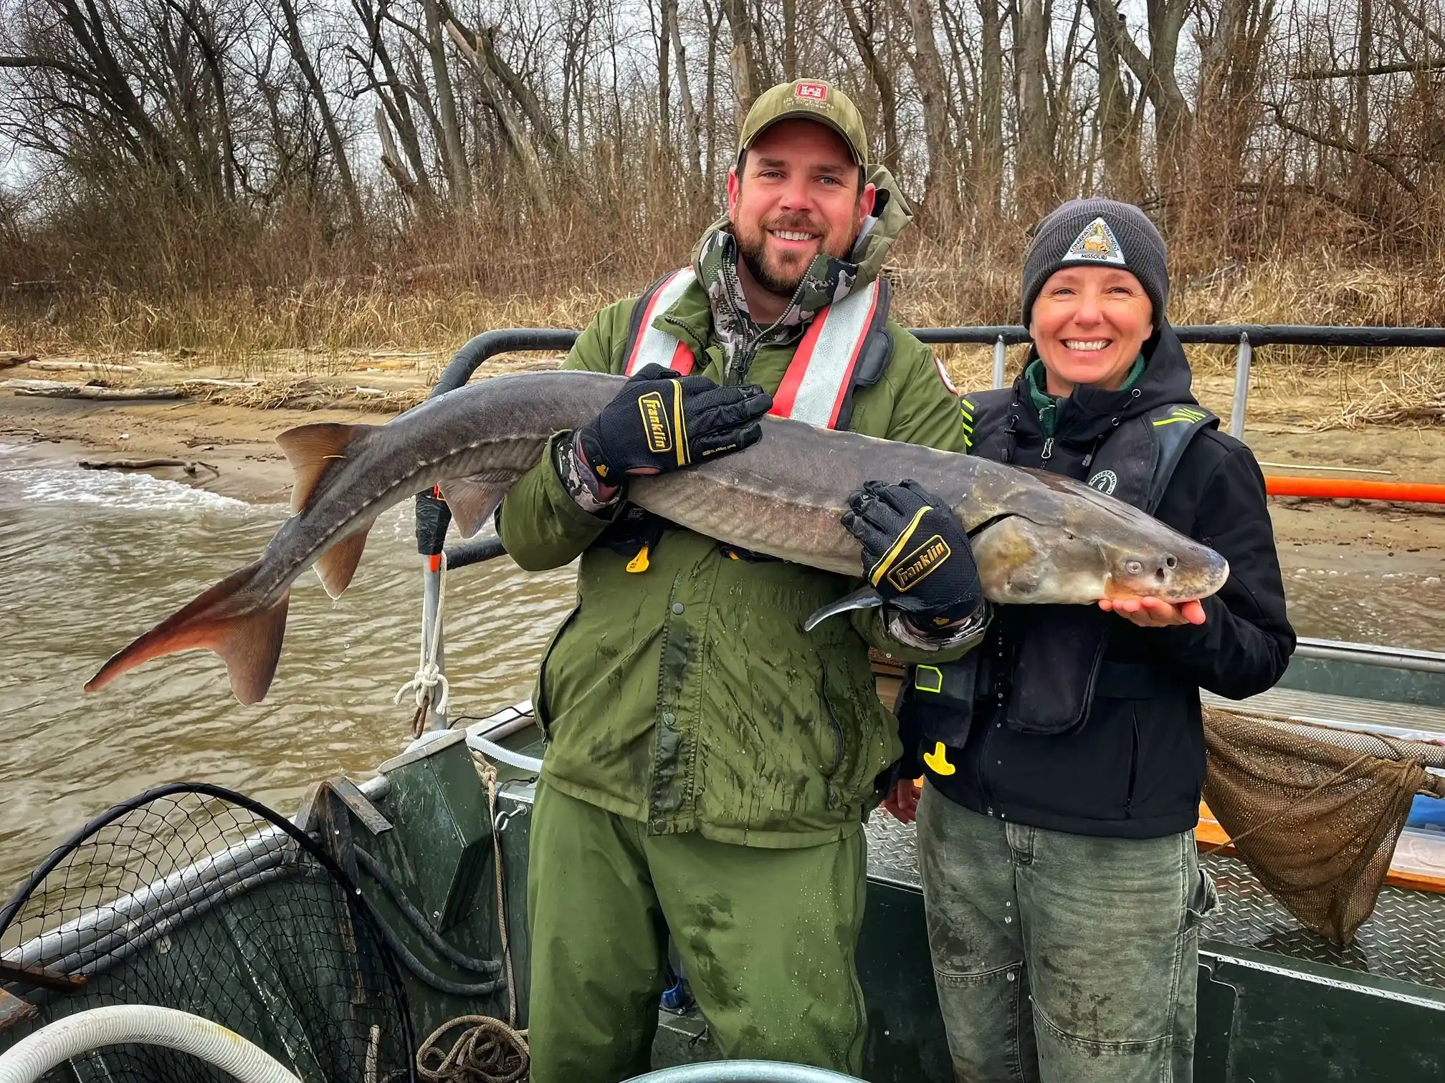
Wildlife Monitoring
Lake Sturgeon
  Endangered in Missouri and Illinois
  Partnership with Missouri Department of Conservation
    Ongoing project showing dam operations can be used to encourage spawning
    Dam gates can be adjusted to change water velocities with minimal impact to operations
      Creates suitable spawning conditions for the sturgeon!
    Sturgeon are monitored using imbedded PIT (passive integrated responder tags) and radio transmitters
      Captured sturgeon are weighed, measured, and fitted with tags before being released

Slide 9

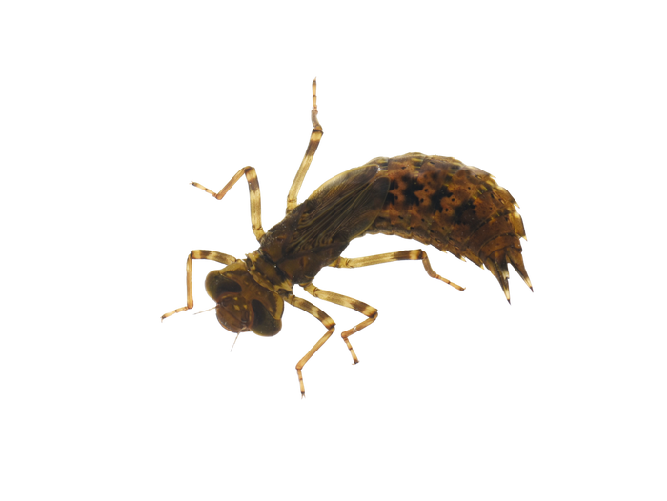
Water Quality Investigators

Slide 10
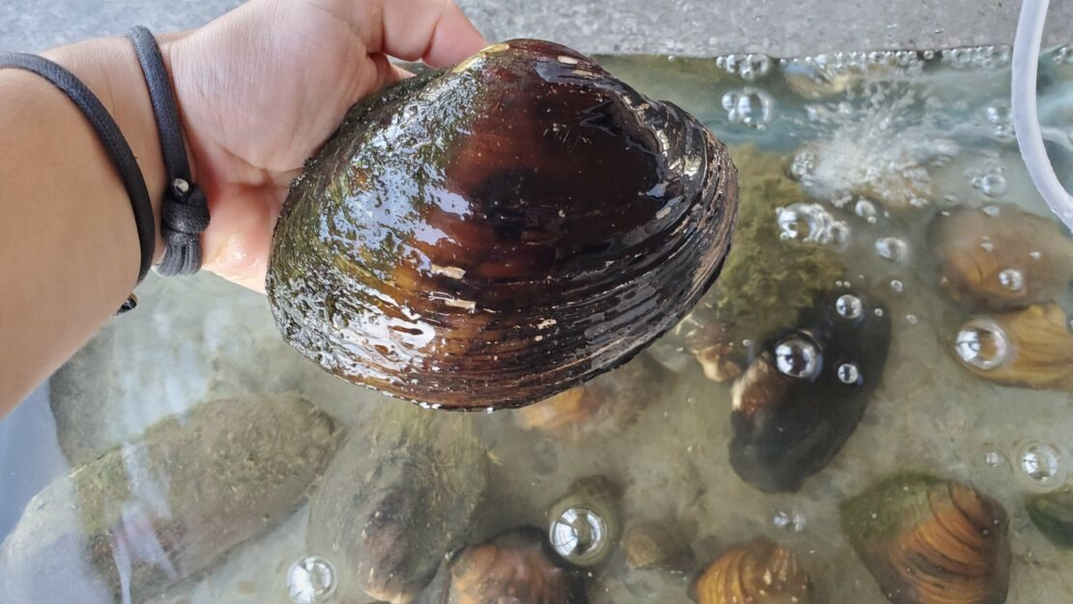
Activity
You will need:
  Macro identification charts
  Water quality worksheet
  Bowls or buckets - one per group
  Macro invertebrate cut-outs
  Pollution cut-outs
  Paper and pencil

Slide 11
Activity
Instructions:
1.Divide into groups. Each group gets:
    One bucket/bowl with a label and description of the habitat
      Macroinvertebrate cut-outs in bucket or bowl
      Pollution cutouts taped to the bottom of the bucket/bowl
    One piece of paper and pencil to tally invertebrates
    One of each Macro identification chart
    One water quality worksheet
2. Ask each group to predict the water quality level of their habitat based on its description
    Have groups write their predictions on their paper
3. Ask groups to each remove one macroinvertebrate and identify it as a team, using their identification chart. Check their IDs and make sure they understand how the chart works.

Slide 12
Activity
Instructions:
4. Have each group continue removing/identifying macro cut-outs and tally the number of each
5. Ask groups to raise their hands and say how many of each invertebrate they found
  Write the name of each habitat and macro tallies on the board
6. Show groups how to use the water quality chart and ask each group to rate the water quality of each habitat
  Write water quality level on the board next to each habitat
7. Have groups turn their buckets upside-down and remove pollutant tags
  Ask groups with pollutant tags to raise their hand and share what they found

Slide 13
In the classroom
  This activity can be catered to various age ranges and provides opportunities to talk about water quality, point-source and non-point-source pollution, and the biology behind why some species are more adapted to low quality than others.
  Further questions
    What was your predicted water quality for your habitat? Was the actual water quality better or worse than what you had expected?
    If your habitat had low water quality, what species did you primarily have? What about high water quality?
    If your habitat had low water quality, what pollutants did you find in the water? Where do you think they came from?
      This is a great segue into discussions about point-source and non-point-source pollution!
  For more ideas, check out “Water Quality? Ask the bugs!” from Project WET

Slide 14
Questions?

